Slide 1
System Testing cont…
Dr. Durga Prasad Mohapatra
Professor, Dept. of CSE,
NIT Rourkela
Notes:
1

Slide 2
Security testing

Slide 3
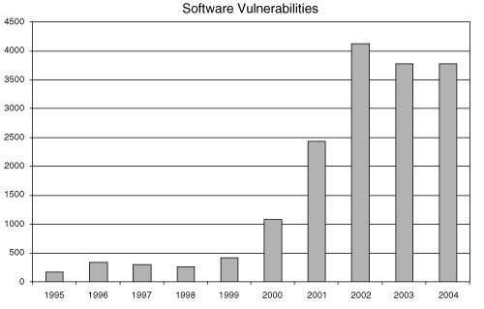
Software Problem
# vulnerabilities Reported by CERT/CC
Notes:
3

Slide 4
More than half of the vulnerabilities are due to buffer overruns.
Others such as race conditions, design flaws are equally prevalent.

Slide 5
Software security
It is about
Understanding software-induced security risks and how to manage them
Leveraging software engineering practice,
Thinking security early in the software lifecycle
Knowing and understanding common problems
Designing for security
Subjecting all software artifacts to thorough objective risk analyses and testing
It is a knowledge intensive field
Notes:
5

Slide 6
Software Security
Renewed interest
“idea of engineering software so that it continues to function correctly under malicious attack”
Existing software is riddled with design flaws and implementation bugs
“any program, no matter how innocuous it seems, can harbor security holes”
Notes:
6

Slide 7
Security Testing
Security is a protection system that is needed to assure the customers that their data will be protected.
For example, internet users feel that their personal data/ information is not secure, the system loses its accountability.
Security may include controlling access to data, encrypting data in communication, ensuring secrecy of stored data, auditing security events, etc.
Security breaches can result in loss of information, privacy violations, denial of service, etc.

Slide 8
Types of Security Requirements
While performing security testing, the following security requirements must be considered:
Security requirements should be associated with each functional requirement.
Each functional requirement, most likely, has a specific set of related security issues to be addressed in the software implementation.
For example, the log on requirement in a client server system must specify the number of retries allowed, the action to be taken if the log-on fails, and so on.

Slide 9
Example of Security Concerns
In addition to the security concerns that are directly related to particular requirements, a software project has security issues that are global in nature, and hence related to the application’s architecture and overall implementation.
For example, a web application may have a global requirement that all private customer data of any kind is stored in encrypted form in the database.
In another example, a system wide security requirement is to use SSL to encrypt the data sent between the client browser and the web server - the testing team should verify the correctness of SSL.

Slide 10
Security Concerns cont…
The problem with security testing is that security-related bugs are not as obvious as other types of bugs.
It may be possible that the security system has failed and caused the loss of information without the knowledge of loss.
Thus, the tester should perform security testing with the goals to identify the bugs that are very difficult to identify.

Slide 11
Software Vulnerability
Vulnerability is an error that an attacker can exploit.
Security vulnerabilities are of the following types:
Bugs at the implementation level, such as local implementation errors or inter-procedural interface errors.
Design level mistakes.
Design level vulnerabilities are the hardest defect category to handle, but they are also the most prevalent and critical.

Slide 12
Software Vulnerability cont…
Unfortunately, ascertaining whether a program has design level vulnerabilities requires great expertise
which makes finding not only difficult but particularly hard to automate.
Examples: problem in error handling, unprotected data channels, incorrect or missing access control mechanisms, and timing errors especially in multithreaded systems.

Slide 13
How to Perform Security Testing
Testers must use a risk based approach, grounded in both the system’s architectural reality and the attacker’s mindset,
to gauge software security adequately.
By identifying risks and potential loss associated with those risks in the system and creating tests driven by those risks
The tester can focus on areas of code in which an attack is likely to succeed.
Therefore, risk analysis can help in identifying potential security problems.
Once identified and ranked, can help in security testing.

Slide 14
Risk Management
Risk management and security testing
Software security practitioners perform many different tasks to manage software risks, including:
Creating security abuse/misuse cases
Listing normative security requirements
Performing architectural risk analysis
Building risk based security test plans
Wielding static analysis tools
Performing security tests.

Slide 15
Risk Management cont…
Three tasks, i.e. architectural risk analysis, risk-based security test planning, and security testing, are closely linked because a critical aspect of security testing relies on probing security risks.
Based on design-level risk analysis and ranking of security related risks, security test plans are prepared which guide the security testing.

Slide 16
Risk Management cont…
Thus, security testing must necessarily involve two diverse approaches:
Testing security mechanisms to ensure that their functionality is properly implemented.
Performing-risk based security testing motivated by understanding and simulating the attacker’s approach.

Slide 17
Elements of Security Testing
Authentication
To establish the validity of a transmission, message, or originator
Authorization
It is the process of determining that a requester is allowed to receive a service or perform an operation.
Availability
It assures that the information and communication services will be ready for use when expected.
Non-repudiation
A measure intended to prevent the later denial that an action happened, or a communication took place, etc.
17

Slide 18
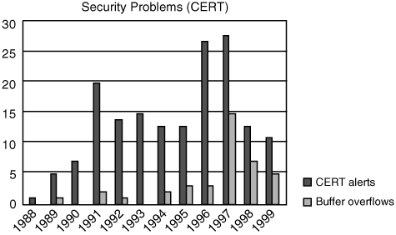
Security problems in software
Bug
An implementation level software problem
Flaw
A problem at a deeper level
Bugs + Flaws
leads to Risk
Notes:
18

Slide 19

Solution … Three pillars of security
Notes:
19

Slide 20
Pillar I: Applied Risk Management
Architectural risk analysis
Sometimes called threat modeling or security design analysis
Is a best practice and is a touchpoint
Risk management framework
Considers risk analysis and mitigation as a full life cycle activity
Notes:
20

Slide 21
Pillar II: Software Security Touchpoints
“Software security is not security software”
Software security
is system-wide issues (security mechanisms and design security)
Emergent property
Touchpoints in order of effectiveness (based on experience)
Code review (bugs)
Architectural risk analysis (flaws)
These two can be swapped
Penetration testing
Risk-based security tests
Abuse cases
Security requirements
Security operations
Notes:
21

Slide 22
Pillar II: (contd.)
Many organization
Penetration first
Is a reactive approach
Code Review and Architecture Risk Analysis can be switched however skipping one solves only half of the problem
Big organizations may adopt these touchpoints simultaneously
Notes:
22

Slide 23
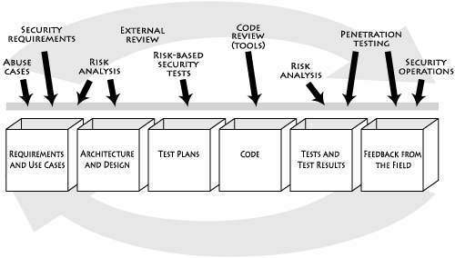
Pillar II: (contd.)
Software security best practices applied to various software artifacts
Notes:
23

Slide 24
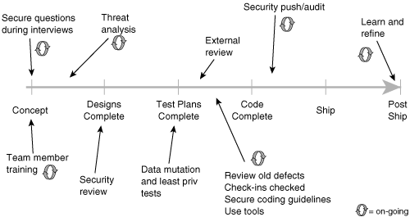
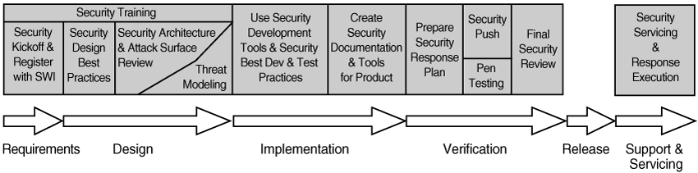
Pillar II: (contd.) Microsoft’s move ...
Notes:
24

Slide 25
Pillar III: Knowledge
Involves
Gathering, encapsulating, and sharing security knowledge
Software security knowledge catalogs
Principles
Guidelines
Rules
Vulnerabilities
Exploits
Attack patterns
Historical risks
Can be put into three categories
Prescriptive knowledge
Diagnostic knowledge
Historical knowledge
Notes:
25

Slide 26
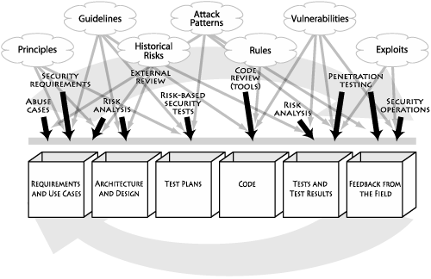
Pillar III: Knowledge catalogs to s/w artifacts
Notes:
26

Slide 27
Risk management framework: Five Stages
RMF occurs in parallel with SDLC activities
Measurement and reporting
Understand
the Business
context
Identify
the Business
and Technical
Risk
Synthesize and
Rank the Risks
Define the Risk
Mitigation
Strategy
1
2
3
4
Artifact Analysis
Business
Context
Carry out fixes
And validate
5
Notes:
27

Slide 28
Stage 1: Understand Business Context
Risk management
Occurs in a business context
Affected by business motivation
Key activity of an analyst
Extract and describe business goals – clearly
Increasing revenue; reducing dev cost; meeting SLAs; generating high return on investment (ROI)
Set priorities
Understand circumstances
Notes:
28

Slide 29
Stage 2: Identify the business & technical risks
Business risks have several impacts
Direct financial loss; loss of reputation; violation of customer or regulatory requirements; increase in development cost
Severity of risks
Should be captured in financial or project management terms
Key is –
tie technical risks to business context
Notes:
29

Slide 30
Stage 3: Synthesize and rank the risks
Prioritize the risks alongside the business goals
Assign risks appropriate weights for resolution
Risk metrics
Risk likelihood
Risk impact
Number of risks mitigated over time
Notes:
30

Slide 31
Stage 4: Risk Mitigation Strategy
Develop a coherent strategy
For mitigating risks
In cost effective manner; account for
Cost Implementation time
Completeness Impact
Likelihood of success
A mitigation strategy should
Be developed within the business context
Be based on what the organization can afford, integrate and understand
Must directly identify validation techniques
Notes:
31

Slide 32
Stage 5: Carry out Fixes and Validate
Execute the chosen mitigation strategy
Rectify the artifacts
Measure completeness
Estimate
Progress, residual risks
Validate that risks have been mitigated
Testing can be used to demonstrate
Develop confidence that unacceptable risk does not remain
Notes:
32

Slide 33
Risk Mitigation Framework - A Multi-loop
Risk management is a continuous process
Five stages may need to be applied many times
Ordering may be interleaved in different ways
Risk can emerge at any time in SDLC
One way – apply in each phase of SDLC
Risk can be found between stages
Level of application
Primary – project level
Each stage must capture complete project
SDLC phase level
Artifact level
It is important to know that Risk Mitigation is
Cumulative
At times arbitrary and difficult to predict
Notes:
33

Slide 34
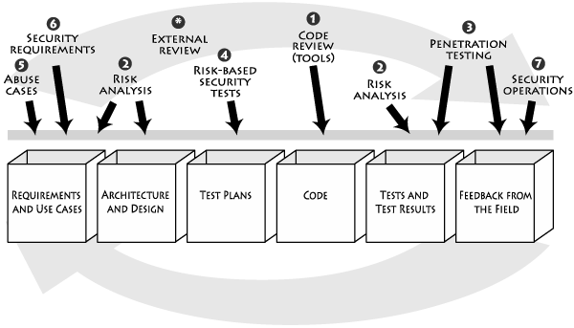
Seven Touchpoints
Notes:
34

Slide 35
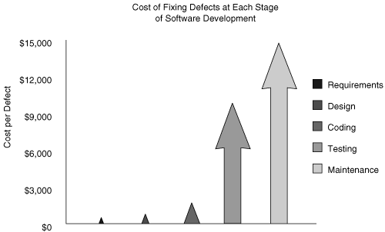
Cost of fixing defect at each stage
Notes:
35

Slide 36
Architectural risk analysis
Design flaws
about 50% of security problem
Can’t be found by looking at code
A higher level of understanding required
Risk analysis
Track risk over time
Quantify impact
Link system-level concerns to probability and impact measures
Fits with the RMF
Notes:
36

Slide 37
ARA within RMF
Identify
the Business
Risk
Measurement and reporting
2
Technical
expertise
Artifact Analysis
Understand
the Business
context
Synthesize and
Rank the Risks
Define the Risk
Mitigation
Strategy
1
4
5
Business
Context
Identify
the Technical
Risk
3
Artifact Analysis
Validate the
artifacts
Fix the artifacts
7
6
Initiate process
improvement
Validation loop
Notes:
37

Slide 38
ARA process
Attack resistance analysis
Steps
Identify general flaws using secure design literature and checklists
Knowledge base of historical risks useful
Map attack patterns using either the results of abuse case or a list of attack patterns
Identify risk based on checklist
Understand and demonstrate the viability of these known attacks
Use exploit graph or attack graph
- Note: particularly good for finding known problems
Notes:
38

Slide 39
ARA process
Ambiguity analysis
Discover new risks – creativity requried
A group of analyst and experience helps – use multiple points of view
Unify understanding after independent analysis
Uncover ambiguity and inconsistencies
Weakness analysis
Assess the impact of external software dependencies
Modern software
is built on top of middleware such as .NET and J2EE
Use DLLs or common libraries
Need to consider
COTS
Framework
Network topology
Platform
Physical environment
Build environment
Notes:
39

Slide 40
Software penetration testing
Most commonly used today
Currently
Outside->in approach
Better to do after code review and ARA
As part of final preparation acceptance regimen
One major limitation
Almost always a too-little-too-late attempt at the end of a development cycle
Fixing things at this stage
May be very expensive
Reactive and defensive
Notes:
40

Slide 41
Software penetration testing
A better approach
Penetration testing from the beginning and throughout the life cycle
Penetration test should be driven by perceived risk
Best suited for finding configuration problems and other environmental factors
Make use of tools
Takes care of majority of grunt work
Tool output lends itself to metrics
Tools for penetration testing
fault injection tools;
attacker’s toolkit: disassemblers and decompilers; coverage tools monitors
Notes:
41

Slide 42
Risk based security testing
Testing must be
Risk-based
grounded in both the system’s architectural reality and the attacker’s mindset
Better than classical black box testing
Different from penetration testing
Level of approach
Timing of testing
Penetration testing is primarily on completed software in operating environment; outside->in
Notes:
42

Slide 43
Risk based security testing
Security testing
Should start at feature or component/unit level testing
Must involve two diverse approaches
Functional security testing
Testing security mechanisms to ensure that their functionality is properly implemented
Adversarial security testing
Performing risk-based security testing motivated by understanding and simulating the attacker’s approach
Notes:
43

Slide 44
Abuse cases
Creating anti-requirements
Important to think about
Things that you don’t want your software to do
Requires: security analysis + requirement analysis
Anti-requirements
Provide insight into how a malicious user, attacker, thrill seeker, competitor can abuse your system
Considered throughout the lifecyle
indicate what happens when a required security function is not included
Notes:
44

Slide 45
Abuse cases
Creating an attack model
Based on known attacks and attack types
Do the following
Select attack patterns relevant to your system – build abuse case around the attack patterns
Include anyone who can gain access to the system because threats must encompass all potential sources
Also need to model attacker
Notes:
45

Slide 46
Security requirements and operations
Security requirements
Difficult tasks
Should cover both over functional security and emergent characteristics
Use requirements engineering approach
Security operations
Integrate the security operations
e.g. software security should be integrated with network security
Notes:
46

Slide 47
Research Motivations
Absence of Data-set: So we are in need of an efficient data-set for analyzing Intrusion Detection Systems.
Machine-Learning Techniques will improve the security by around 200%.
Marking threats according to their effect on vulnerability is needed to draw architecture for software security.
All Viruses, Trojans and Malwares should be studied and handled carefully to make our system strong enough against these, in real- time.
Notes:
47

Slide 48
Latent Errors: How Many Errors are Still Remaining?
Make a few arbitrary changes to the program:
Artificial errors are seeded into the program.
Check how many of the seeded errors are detected during testing.

Slide 49
Error Seeding
Let:
N be the total number of errors in the system
n of these errors be found by testing.
S be the total number of seeded errors,
s of the seeded errors be found during testing.

Slide 50
Error Seeding
n/N = s/S
N = S n/s
Remaining defects: N - n = n ((S - s)/ s)

Slide 51
Quiz 2
100 errors were introduced.
90 of these errors were found during testing
50 other errors were also found.
Find errors remaining in code.

Slide 52
Quiz 2: Solution
100 errors were introduced.
90 of these errors were found during testing
50 other errors were also found.
Remaining errors= 50 (100-90)/90 = 6

Slide 53
Challenges in Error Seeding
The kinds of seeded errors should match closely with existing errors:
However, it is difficult to predict the types of errors that exist.
Categories of remaining errors:
can be estimated by analyzing historical data from similar projects.

Slide 54
Quiz 3
Before system testing 100 errors were seeded.
During system testing 90 of these were detected.
150 other errors were also detected
How many unknown errors remain after system testing?

Slide 55
Summary
Discussed security testing in detail.
Discussed Types of Security Requirements
Explained Software Vulnerability.
Presented the Elements of Security Testing.
Discussed the Security problems in software and the solution.
Discussed how to know the latent errors.

Slide 56
References
Rajib Mall, Fundamentals of Software Engineering, (Chapter – 10), Fifth Edition, PHI Learning Pvt. Ltd., 2018.
Naresh Chauhan, Software Testing: Principles and Practices, (Chapter – 7), Second Edition, Oxford University Press, 2016.

Slide 57
THANK YOU

